Slide 1

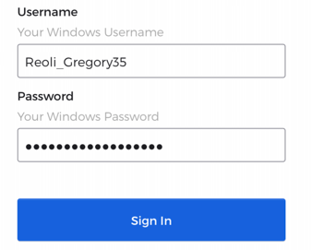
Mobile Login Instructions for The River
Click Use Custom Domain
(No need to enter username or password on this screen)
Enter Custom Domain
Jamesriverequipment
- or –
4riversequipment
Use your windows username and password here (OKTA Login)
The format for your username is:
LastName_FirstNameXX
The password is the one used for logging into your computer.
Example:
4 Rivers Example:

