Slide 1


Welcome Aboard!!!

Slide 2
The River – Email Onboarding – Contents
Reset password using email sent from Salesforce (Laptop)
Download Salesforce App on Mobile and Log In (Mobile)
Einstein Activity Capture Set Up (Laptop)
Office 365 Integration Set Up (Laptop)
Navigation/Header Tour
Future Log In Instructions
NOTE: Workflow and Requests are not functional at this time and are expected to be complete by mid-August. Continue to use your current processes as we work to implement these. Your feedback and examples are welcome as we build/customize these processes.

Slide 3
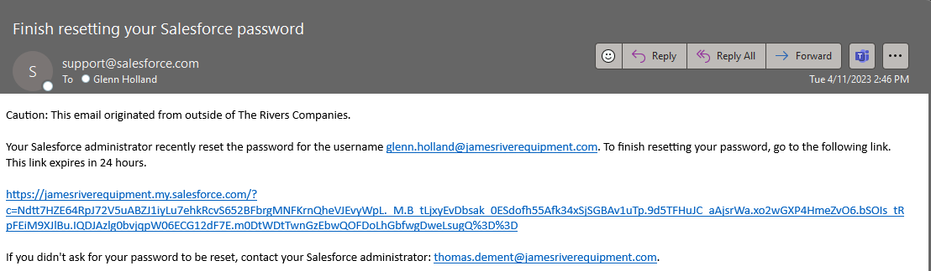
#1. Reset password using email sent from Salesforce
Make note of your username (email address) as it will be used for logging in to your Mobile/Tablet App.
Click this link and make sure you bookmark it in your web browser (Chrome preferred).

Slide 4
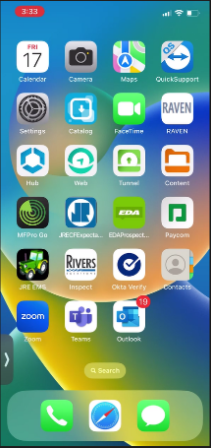
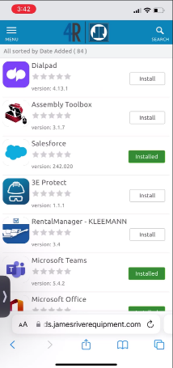
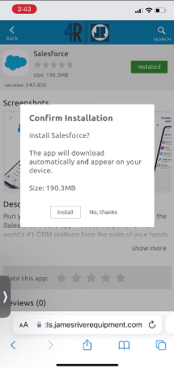
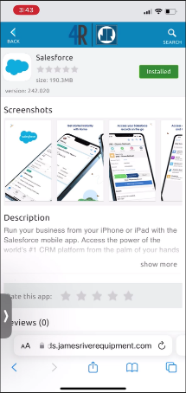
#2. Download Salesforce App on Mobile and Log In
Go to Apple App Store or JRE Catalog (above left screenshot) and install Salesforce.
Username is your James River Email and the password you set up in step #1.

Slide 5
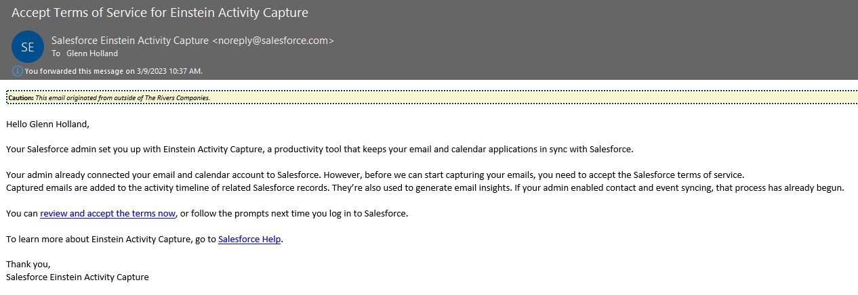
#3. Einstein Activity Capture (1 of 6)
Salesforce will be sending you an Email asking you to accept the terms of service for Einstein Activity Capture.
Click the link, will take you to “The River”.

Slide 6
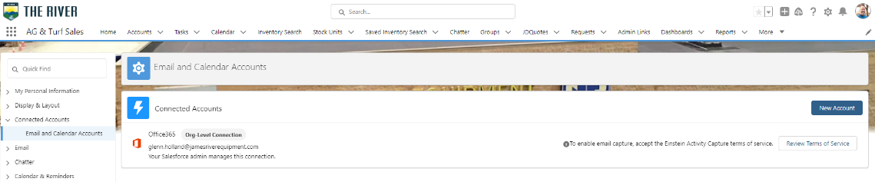
#3. Einstein Activity Capture (2 of 6)
Here is where you will gain access to review the Terms of Service.
Click the link to Review the Terms of Service.

Slide 7
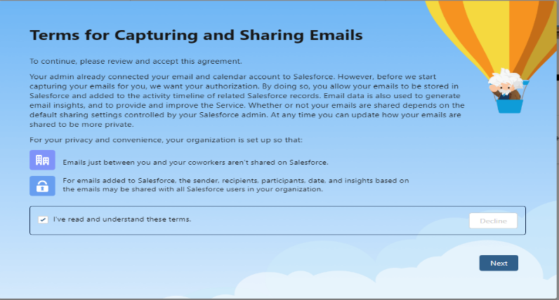
#3. Einstein Activity Capture (3 of 6)
Once you have reviewed the Terms, follow below.
Check the box then click “Next”.

Slide 8
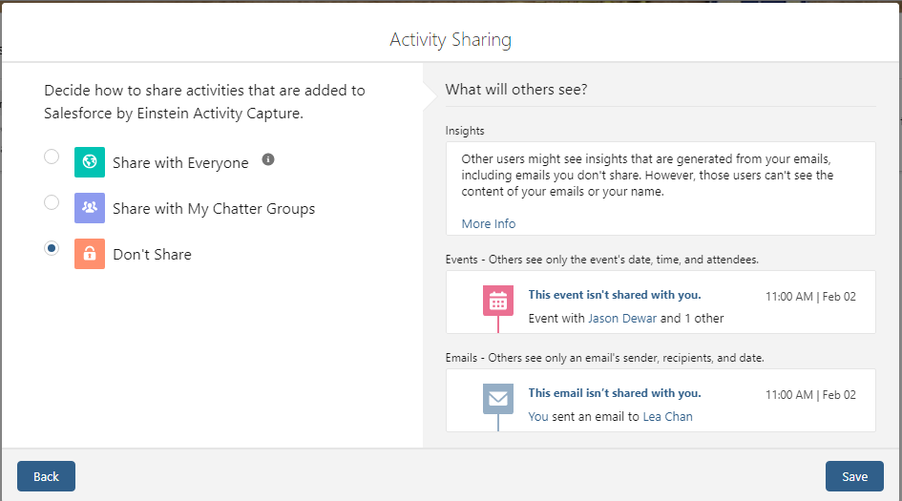
#3. Einstein Activity Capture (4 of 6)
Activity Sharing Information and setting.
Choose “Don’t Share” and then click save.

Slide 9
#3. Einstein Activity Capture (5 of 6)
Confirmation Banner should pop up as shown below.
Note: It may take up to 48 hours for full integration to be complete between Office 365 and The River.

Slide 10
#3. Einstein Activity Capture (6 of 6)
Sending and receiving emails from Office 365 will log to The River in the record’s activity window if a record is found.
  If there are multiple similar records in the The River, you can choose where it is logged to.
  You will have visibility to if and when the email was opened/responded by the recipient.
  You can remove/modify associations as required.
  You can exclude email addresses that have associations that you do want to.
  If you are viewing another User’s email in a Record and they are not sharing with you, you may request the individual email be shared or all future emails from that User.
Creating Events in Office 365 will be available in The River and vice versa.
  You can choose what calendars you want/don’t want to view in The River.
  If choosing to create an event in The River, you can mark it as Private and it will not show in your Office 365 Calendar.

Slide 11
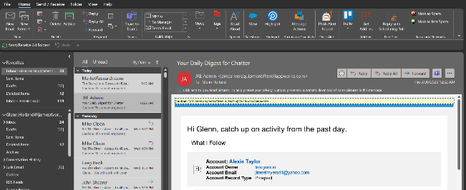

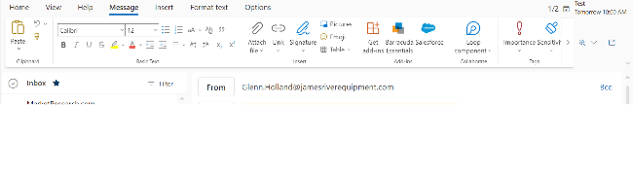

#4. Office 365 Integration Set Up (1 of 4)
Desktop Version
Web Version
NOTE: For Web Version of Outlook, you may have to expand the ribbon using the 3 dots on the far right to see the icon.
Ensure you see the Salesforce Icon in Outlook (if not, open IT ticket to ask for assistance)

Slide 12
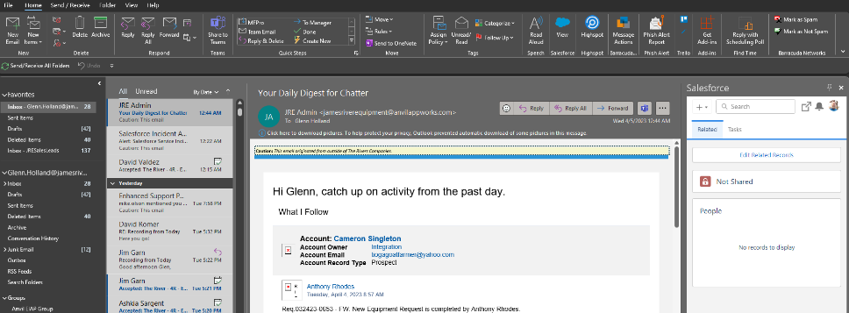
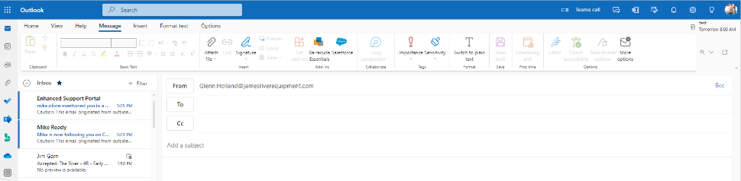
#4. Office 365 Integration Set Up (2 of 4)
Click the Salesforce icon.
Desktop Version
Web Version
NOTE: For Web Version of Outlook, you may have to expand the ribbon using the 3 dots on the far right to see the Salesforce Icon.

Slide 13
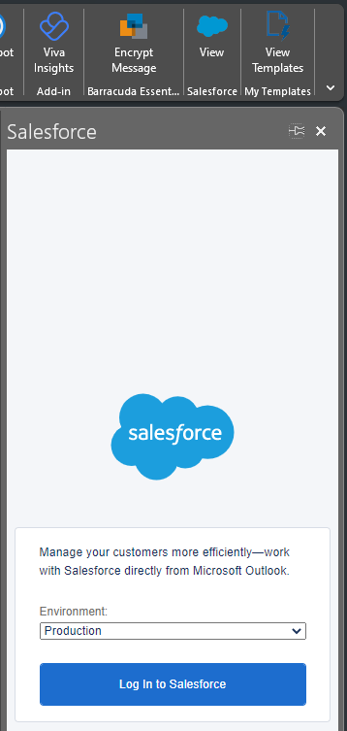


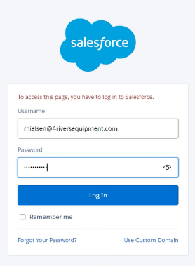
#4. Office 365 Integration Set Up (3 of 4)
Unpinned
A Salesforce pop up window will appear to the right. Pin this view for now (you can always unpin later). Ensure the Environment selection is “Production” and click “Log In to Salesforce”.
NOTE: The web version may ask you if it is ok to open in a new window, click “OK”.
Pinned
On the next Salesforce pop up window, enter your “The River” Username (James River or 4Rivers Email Address) and your “The River” Password, then click “Log In”.

Slide 14
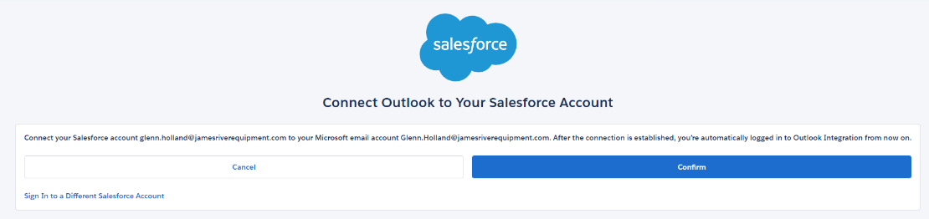
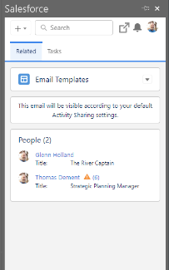
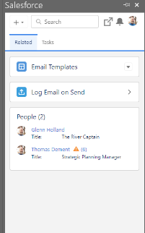
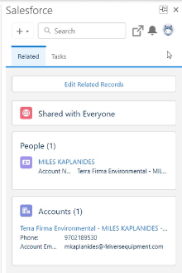

#4. Office 365 Integration Set Up (4 of 4)
Next step… please click “Confirm”.
Finally, click “New Email” from Outlook.
If you see “Log Email on Send” (picture on far right, something did not sync right. Please try process again and reach out to Glenn Holland (me) via email/Teams if still an issue.
You should now see a view similar to this.

Slide 15
#5. Navigation/Header Tour
The River - Header Tour
F
J
H
E
G
I
C
D
B
A
K
App Launcher (A)-View and switch between The River’s apps and connected apps.
The Navigation Bar (B)- Primary way to access The River’s objects and features.
The River’s Header (C)
Global Search (D)-Find stock units/tag #’s, accounts, groups, etc… includes Einstein Search functionality.
Favorites (E)-Mark and manage favorite stock units/tag #’s, accounts, groups, etc…
Global Actions (F)-Create tasks and events, prospects, log actions, emails and more.
Guidance Center (G)-Learning library (not customized to The River).
Help (H)-Get help and training resources, including walkthroughs, videos, and Trailhead (not customized to The River)
Notifications (I)-Keep track of your notifications, including task reminders, Chatter post mentions, and approval requests. The Notifications icon informs you when you have unread notifications. And you can quickly jump to the details from the notifications list.
Profile and Personal Settings (J)-Access your Chatter profile and view or update your personal settings.
Edit Navigation Bar (K)-Personalize your navigation bar.

Slide 16
#6. Future Log In Instructions
There will be two different methods to logging into The River depending on which device you are logging in from.
Laptop
  Use the Log in with Okta option. Your username/password will be your WINDOWS USERNAME AND WINDOWS PASSWORD. This is the credentials you use to log in to your computer.
Mobile or Tablet
  Your username/password will be your JAMES RIVER, 4 RIVERS or FOURSIGHT EMAIL ADDRESS AND THE RIVER PASSWORD. This is the password you created in The River after clicking the reset password link in the email sent to you when 1st logging in or after you have subsequently changed your The River password.

Slide 17
That’s It For Now…
Get ready for a whole new world!

